Slide 1
GeACT Comparison with DESCARTES & Update
11/21/2020
Notes:
大家好，今天我总结一下GeACT。

Slide 2
Part1: Transcriptome

Slide 3
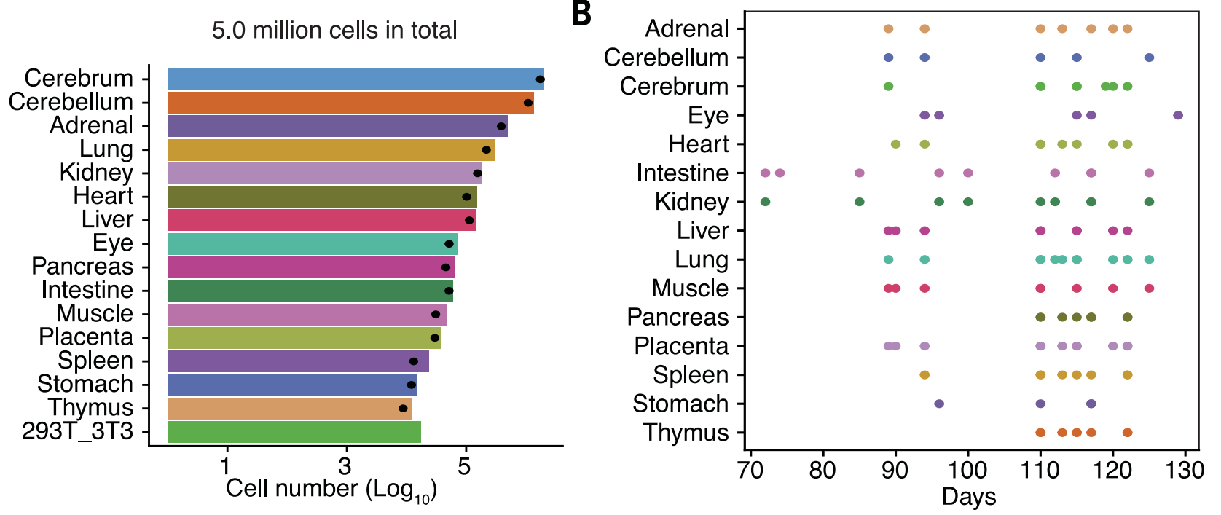
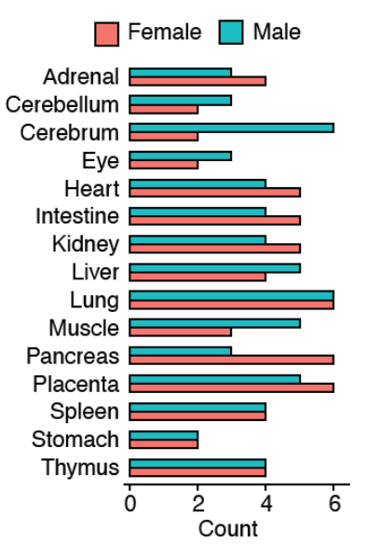
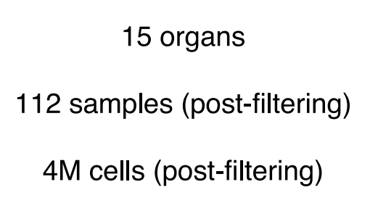
1. Cell number
Bladder
Bone marrow
Bronchus
Diaphragm
Esophagus
Ovary
Testis
17
7
4,062,980
37,269
(Cao et al., Science, 2020)
DESCARTES
GeACT

Slide 4
2. Sample stage
10~14-week-old: 70~98 days
19~21-week-old: 133~147 days
(Cao et al., Science, 2020)

Slide 5
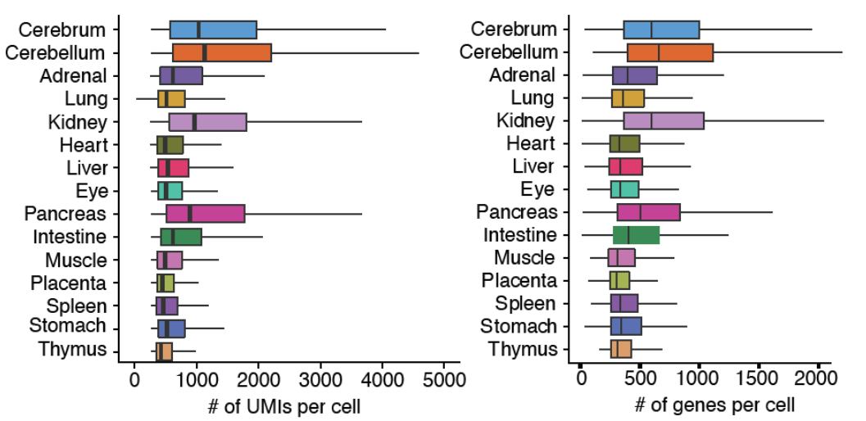
3. Detectability
Technology: sci-RNA-seq3 (proposed in Cao et al., Nature, 2019)
Median: 863
Median: 524
21,611
4,563
(Cao et al., Science, 2020)

Slide 6
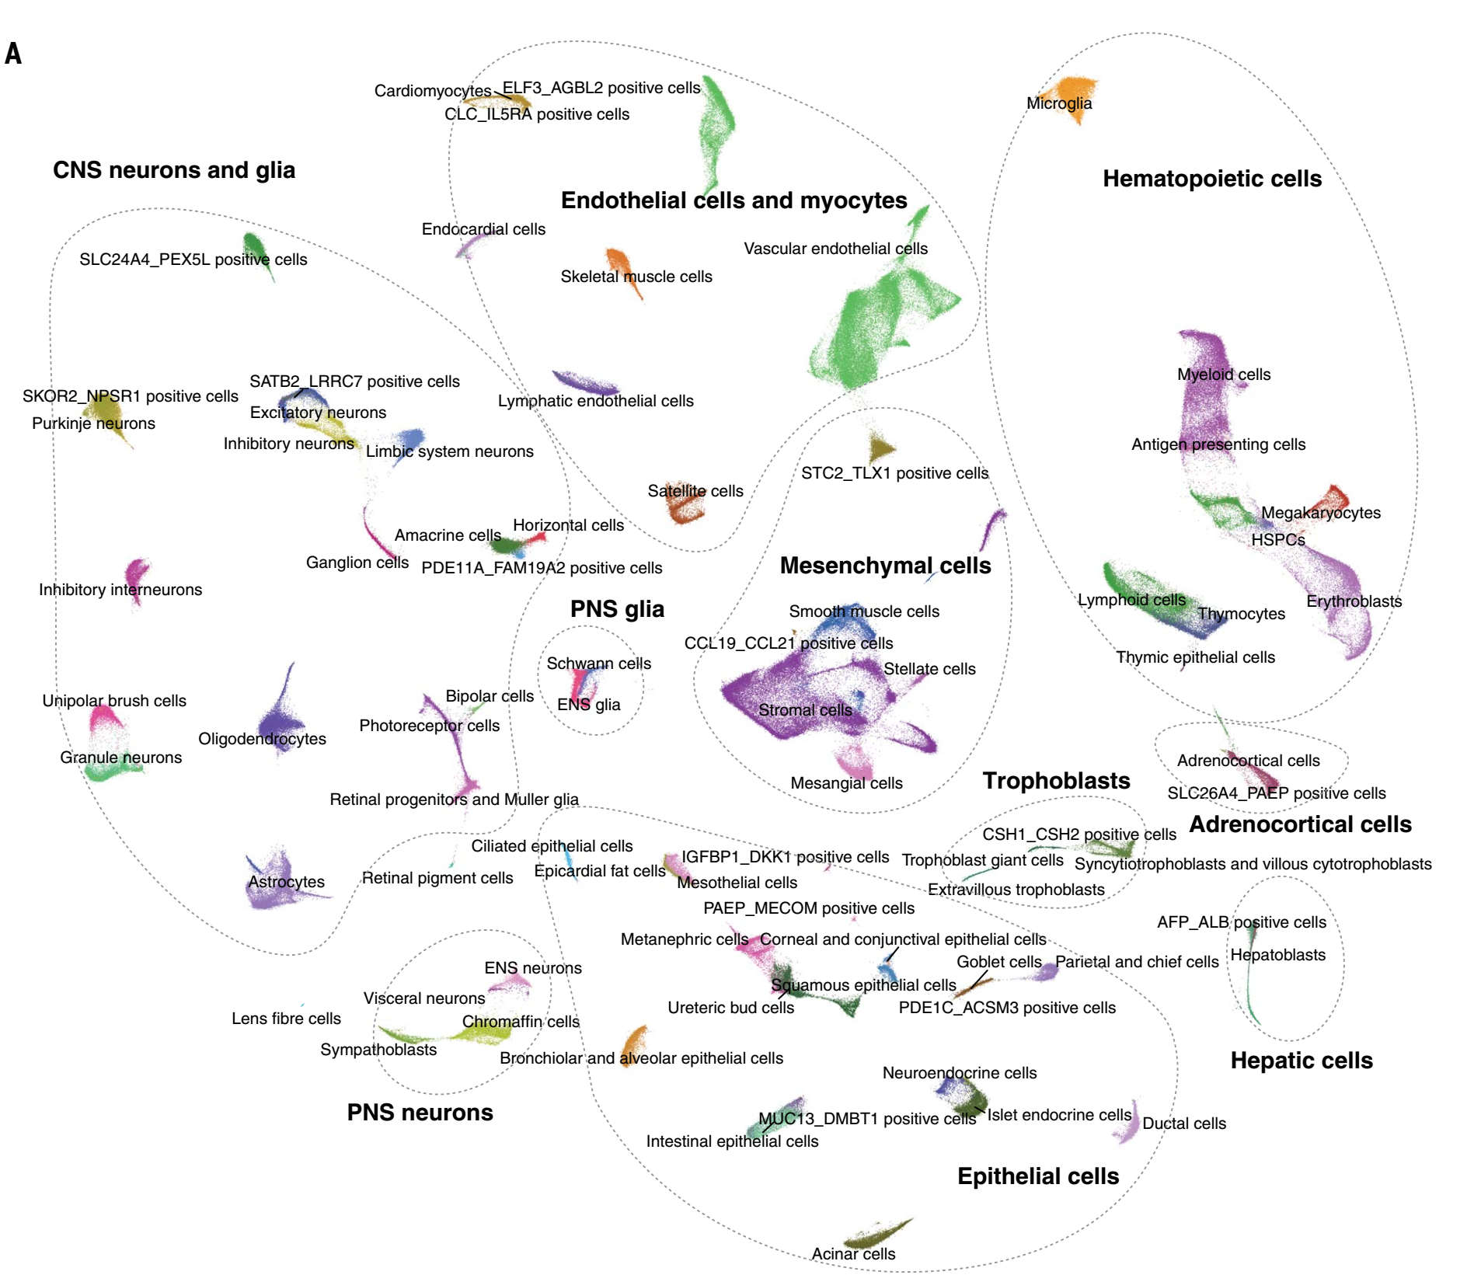
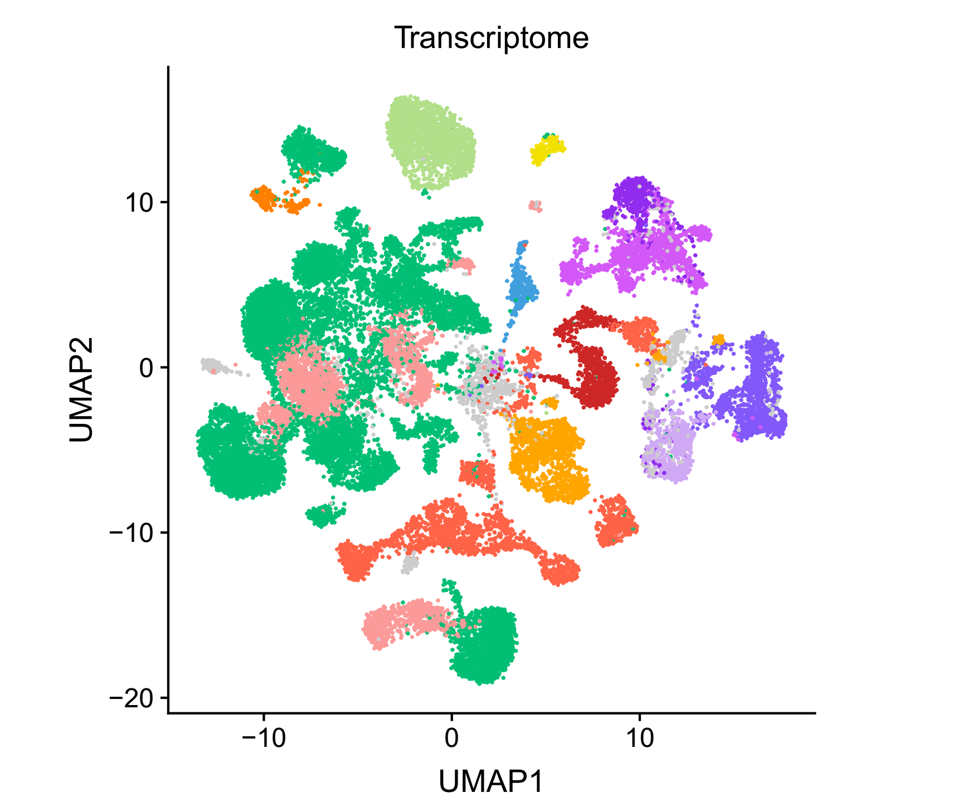
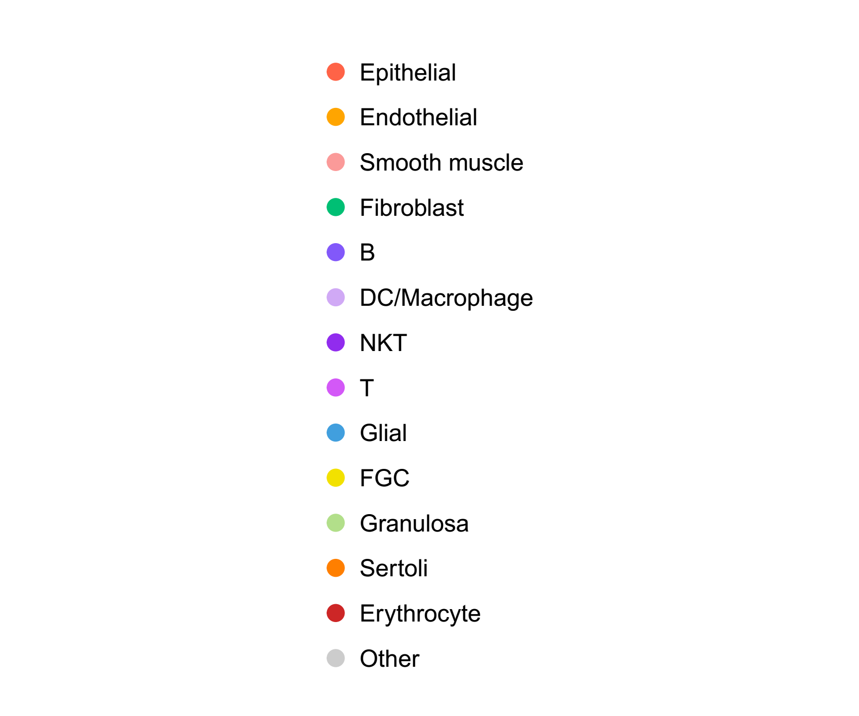
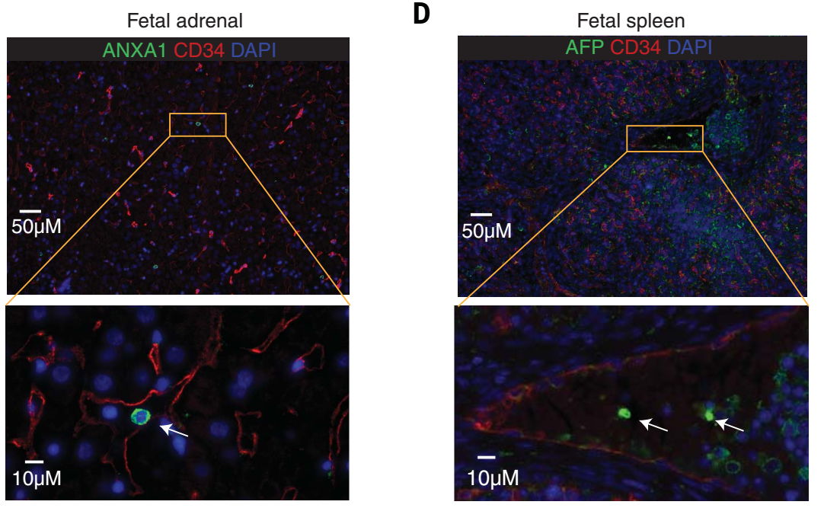
4. Cell type annotation
(Cao et al., Science, 2020)
Notes:
77 main cell types
657 cell subtypes

Slide 7
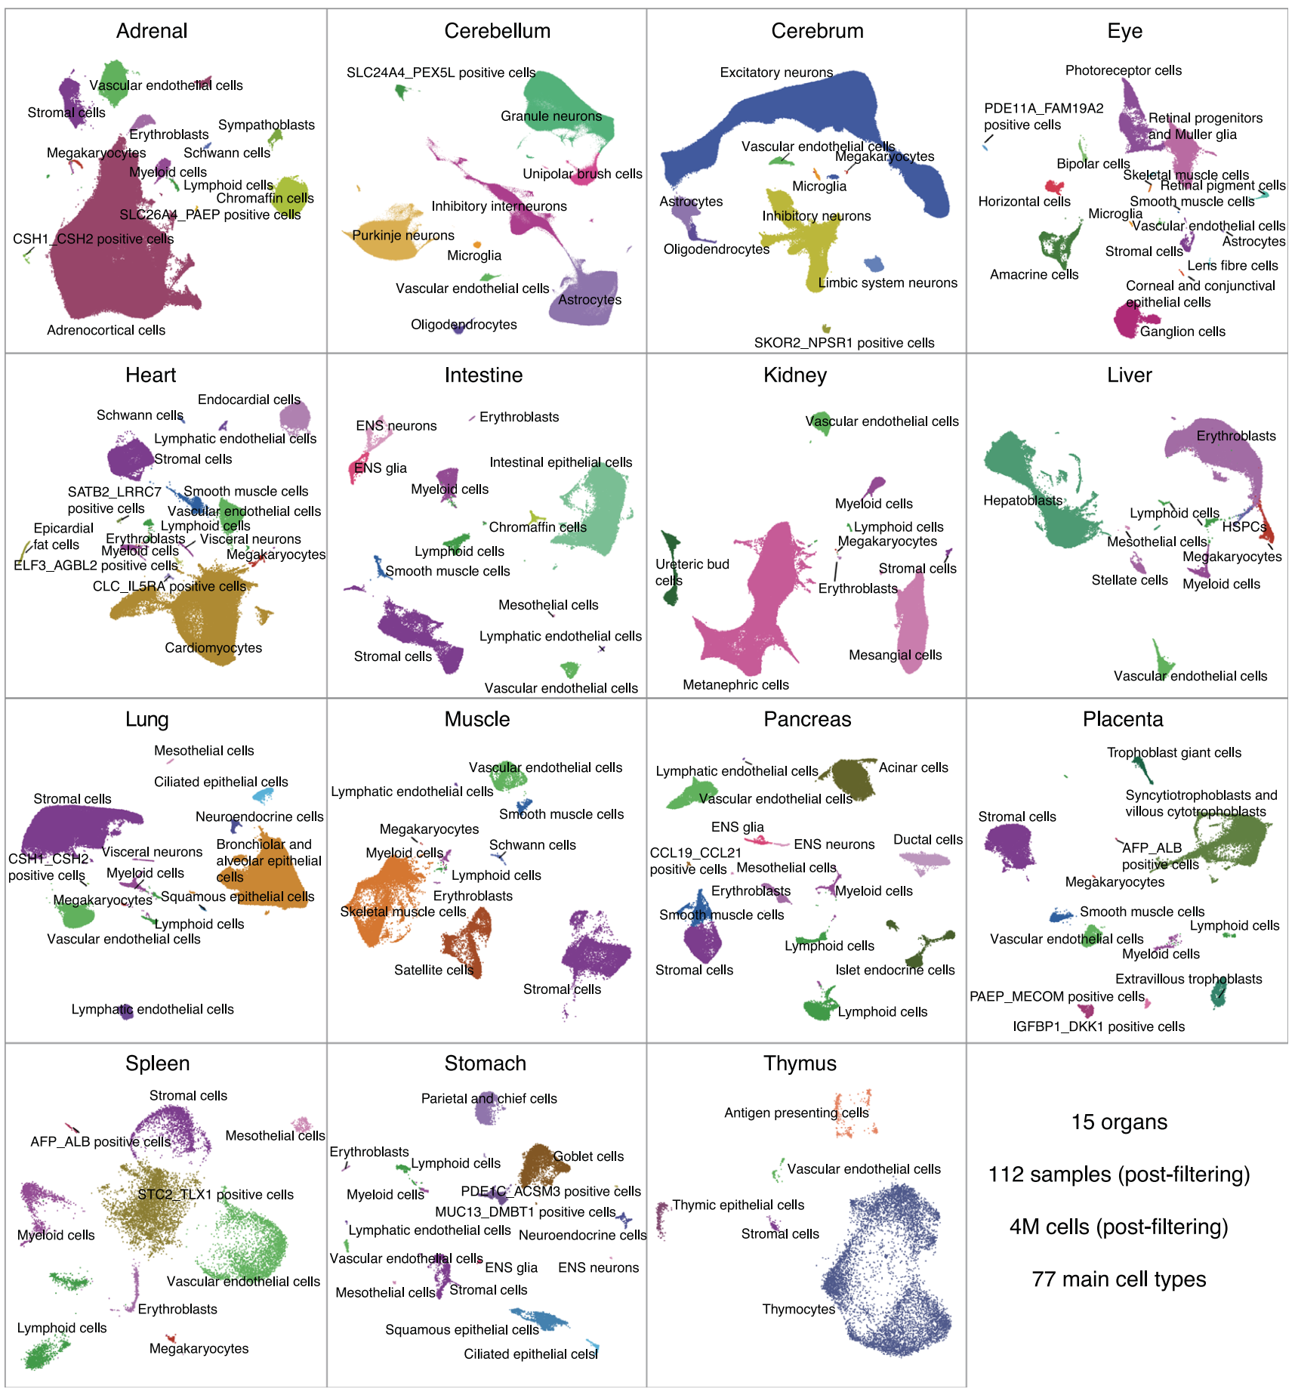
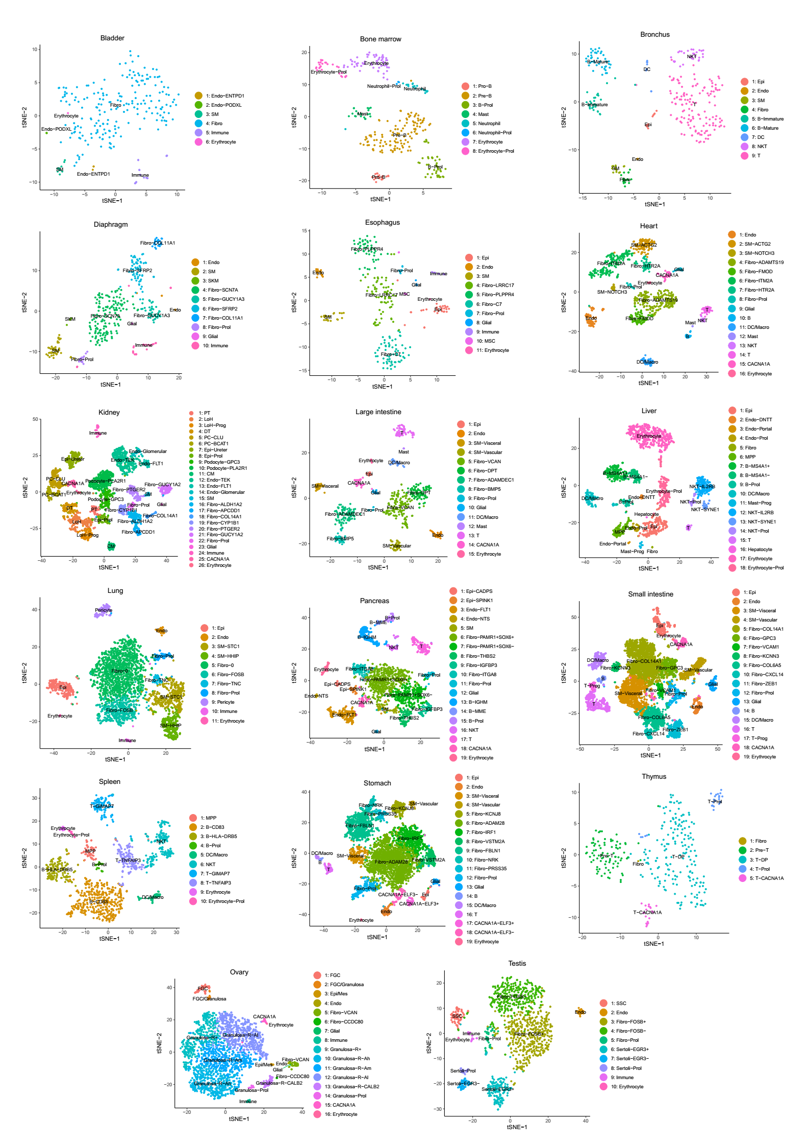
5. Landscape
(Cao et al., Science, 2020)
Notes:
77 main cell types
657 cell subtypes

Slide 8
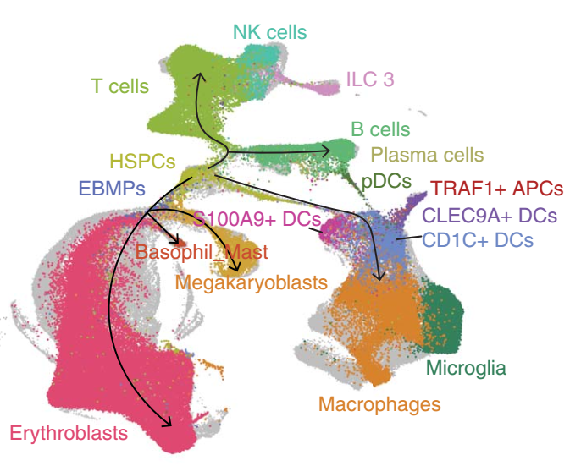
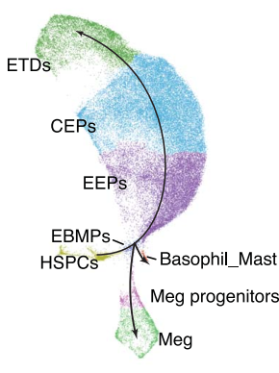
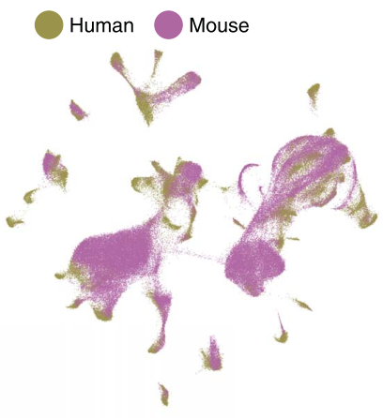
6. Research
Blood cell subtypes and developmental trajectories.
Erythropoiesis and macrophage differentiation in adrenal gland.
Integration of human fetal and mouse embryonic cell atlases (MOCA)
(Cao et al., Science, 2020)
Notes:
77 main cell types
657 cell subtypes

Slide 9
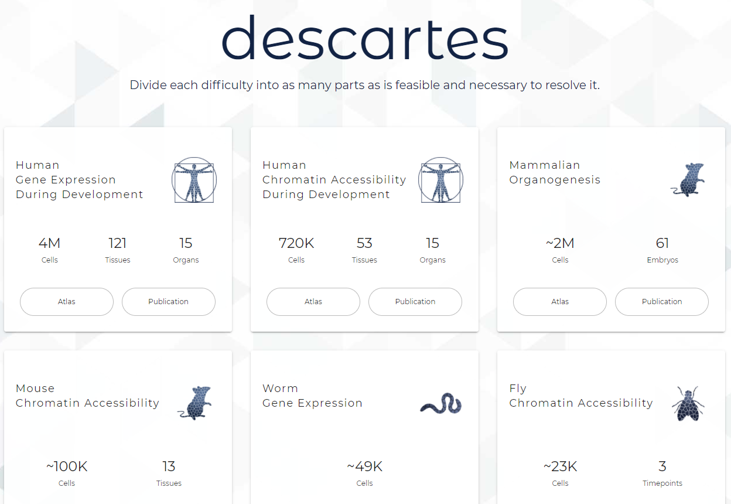
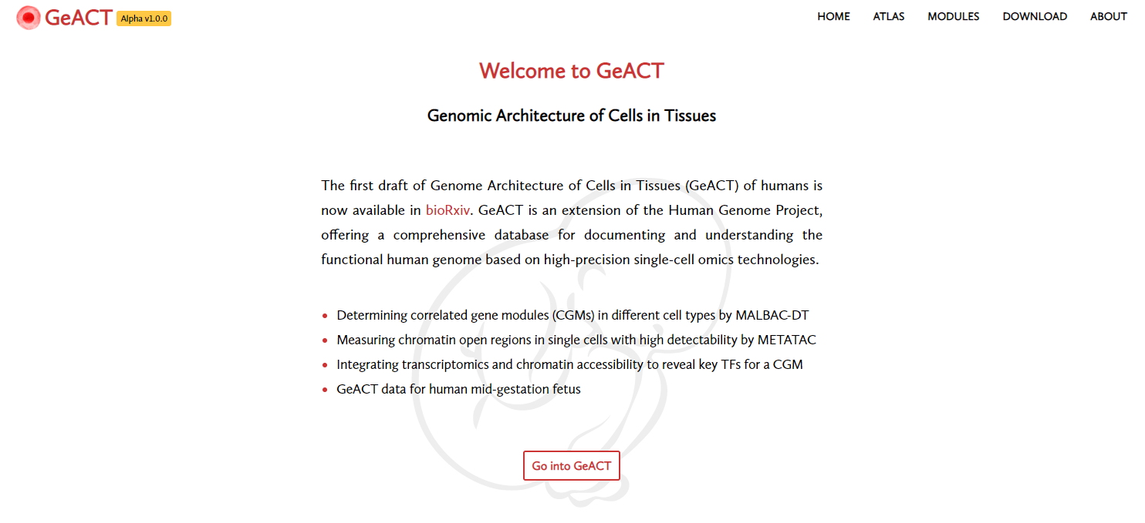
7. Website
https://descartes.brotmanbaty.org/
(Cao et al., Science, 2020)
Notes:
77 main cell types
657 cell subtypes

Slide 10
Part2: Chromatin accessibility

Slide 11
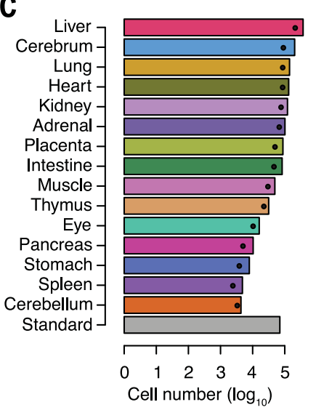
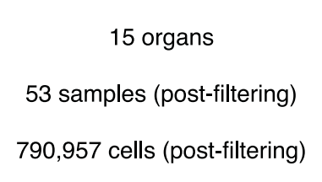
C1. Cell number
14+?
7+?
21,381+?
(Domcke et al., Science, 2020)

Slide 12
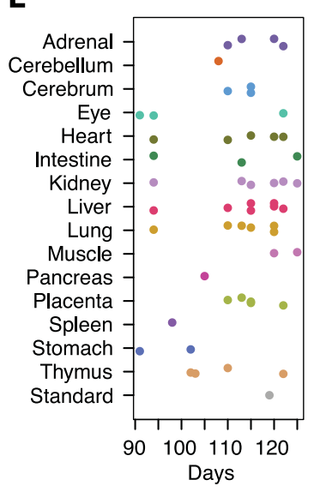
C2. Sample stage
(Domcke et al., Science, 2020)

Slide 13
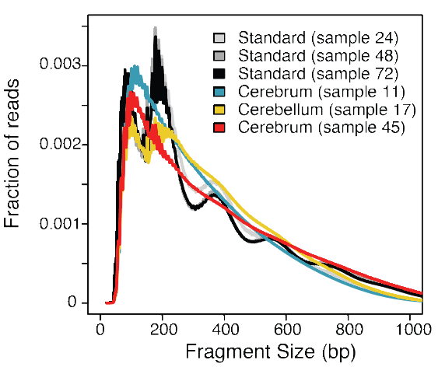
C3. Resolution
Technology: sci-ATAC-seq3 (proposed in this work; with Cusanovich lab)
(Domcke et al., Science, 2020)

Slide 14
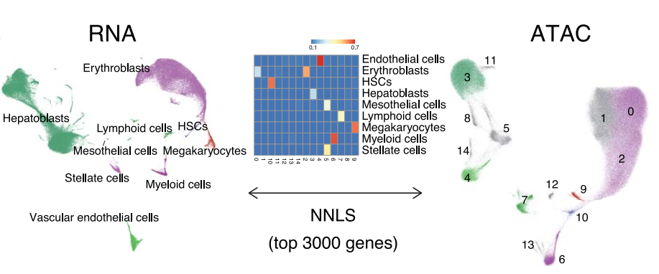
C4. Cell type annotation
(Domcke et al., Science, 2020)

Slide 15
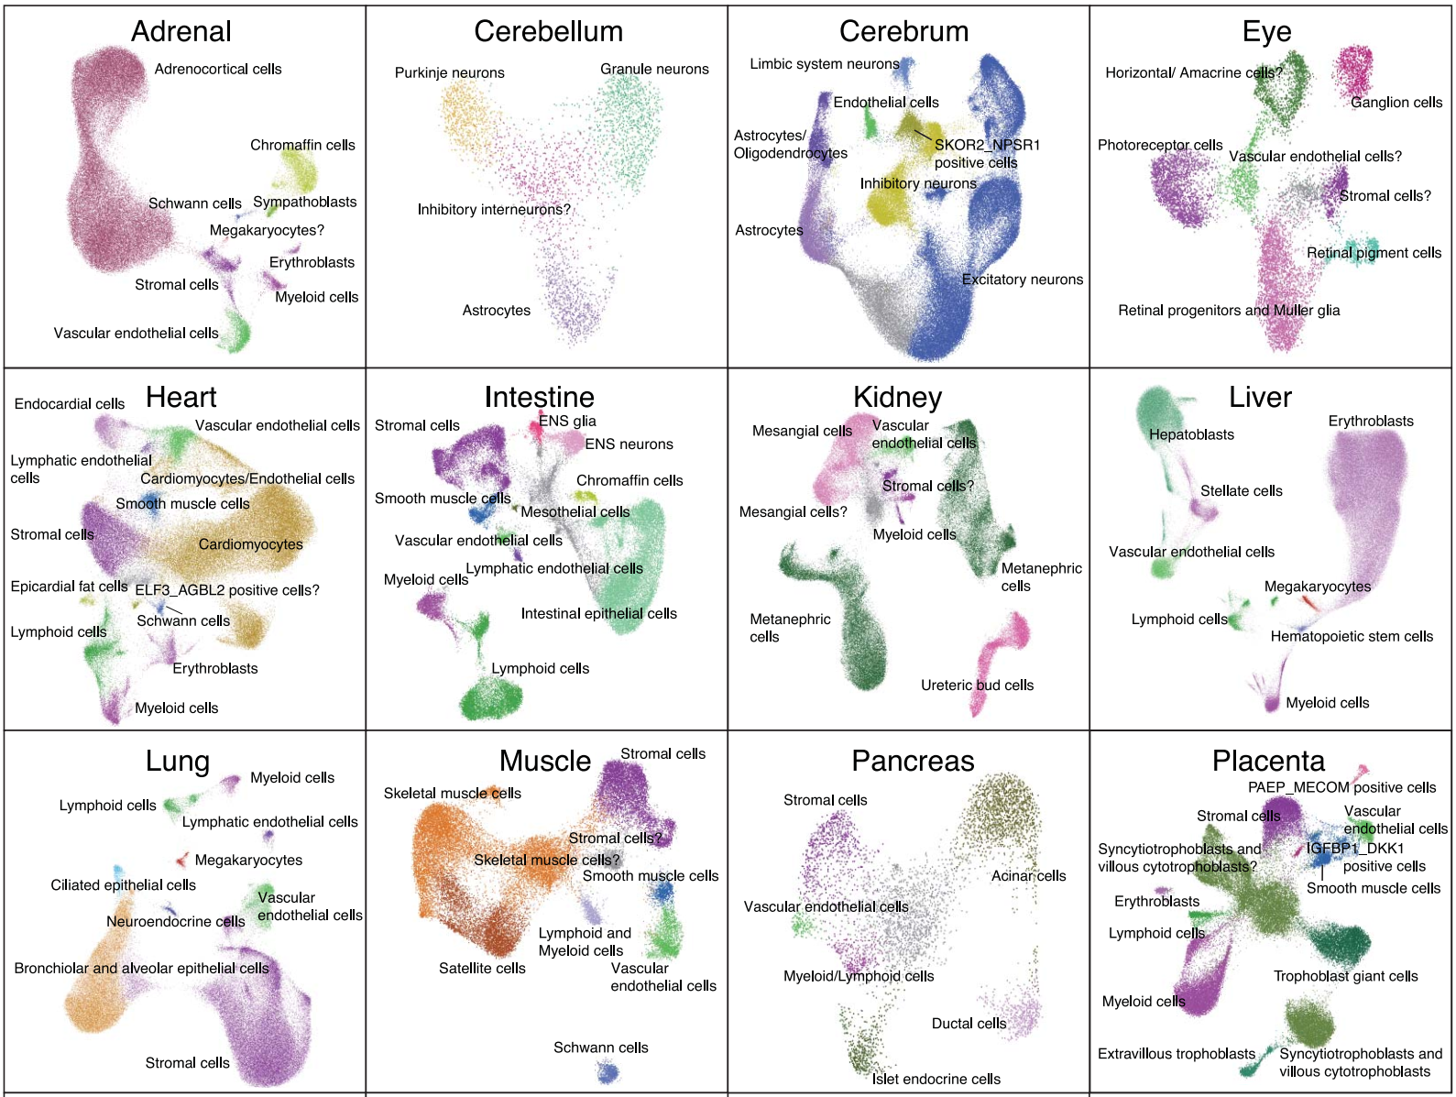
C5. Landscape
(Domcke et al., Science, 2020)

Slide 16
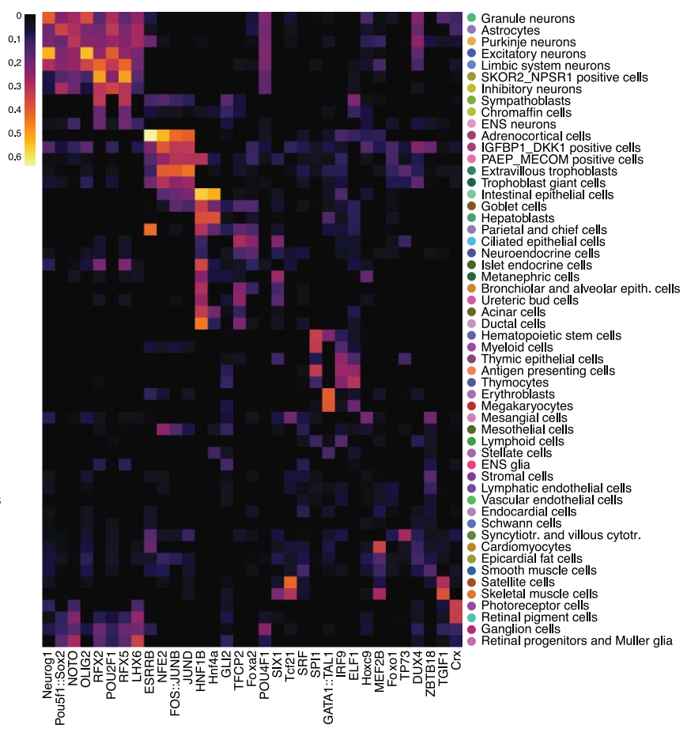
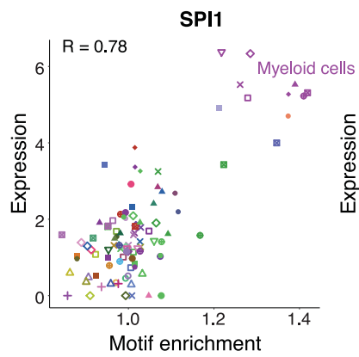
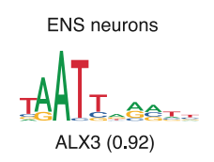
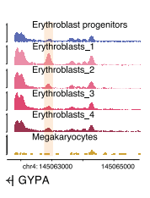
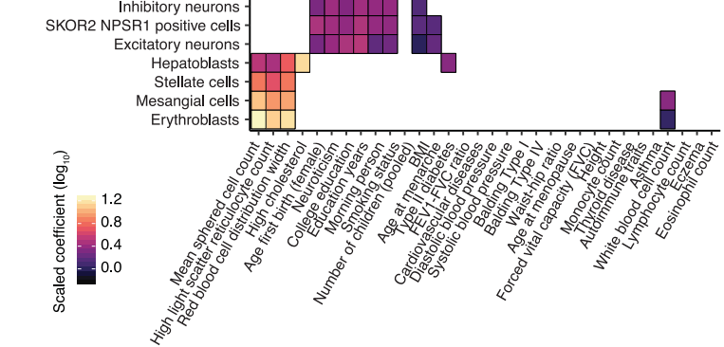
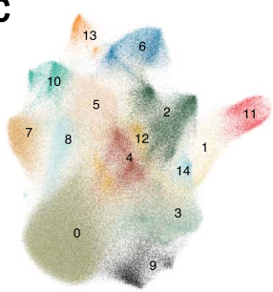
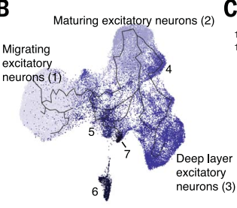
C6. Research
Identifying key TF regulators of cell type–specific chromatin accessibility and their modes of action
Identifying major subgroups and associated TFs in broadly distributed lineages
Heritability enrichment and coaccessibility of candidate regulatory regions
Chromatin accessibility dynamics in developing excitatory neurons
Open region module
(Domcke et al., Science, 2020)
Notes:
identifying genetic variants that affect chromatin accessibility in cis

Slide 17
C7. Website
https://descartes.brotmanbaty.org/
(Domcke et al., Science, 2020)
Notes:
77 main cell types
657 cell subtypes

Slide 18
Part3: GeACT update

Slide 19
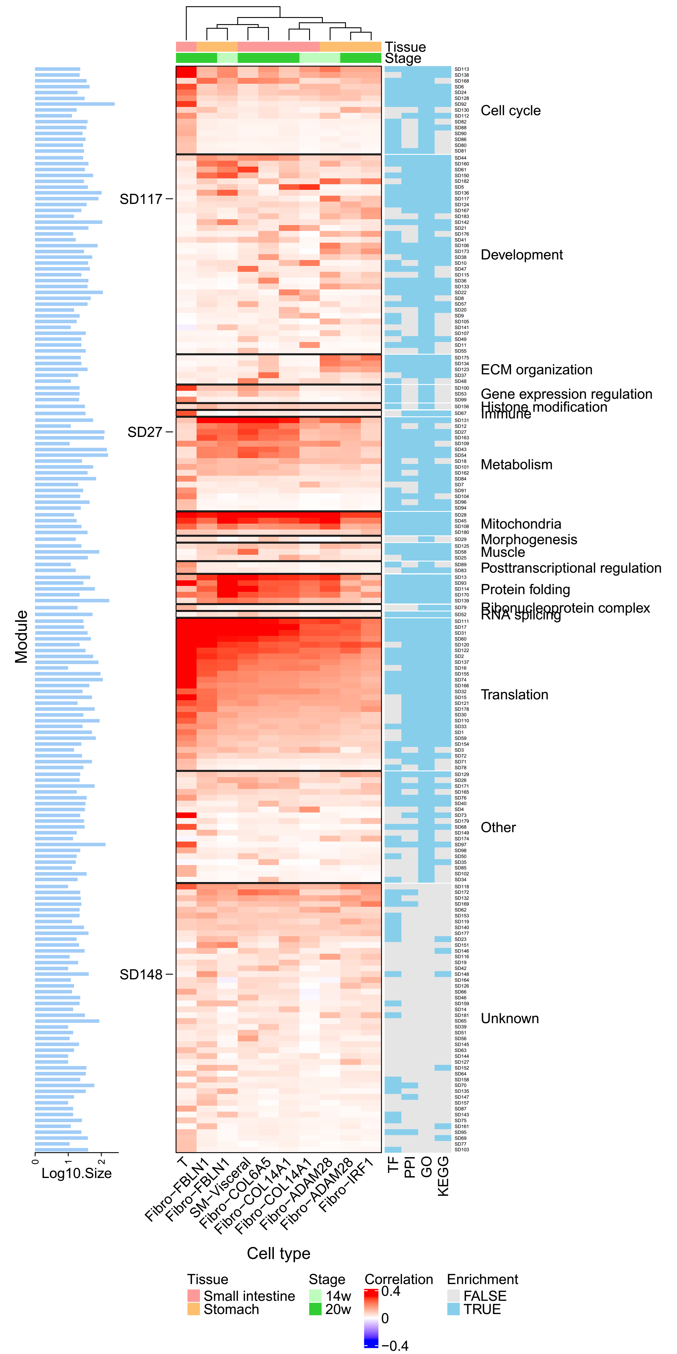
1. Differential modules between different stages
Notes:
77 main cell types
657 cell subtypes

Slide 20
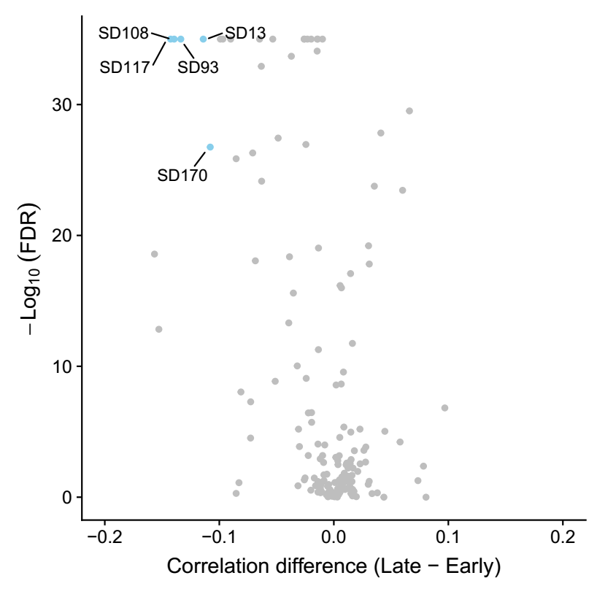
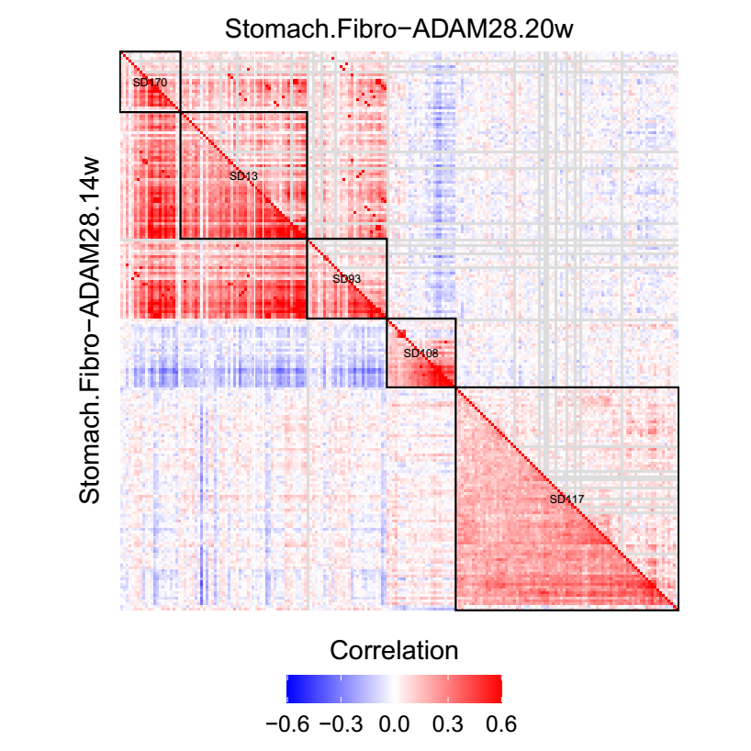
1. Differential modules between different stages
Notes:
77 main cell types
657 cell subtypes

Slide 21
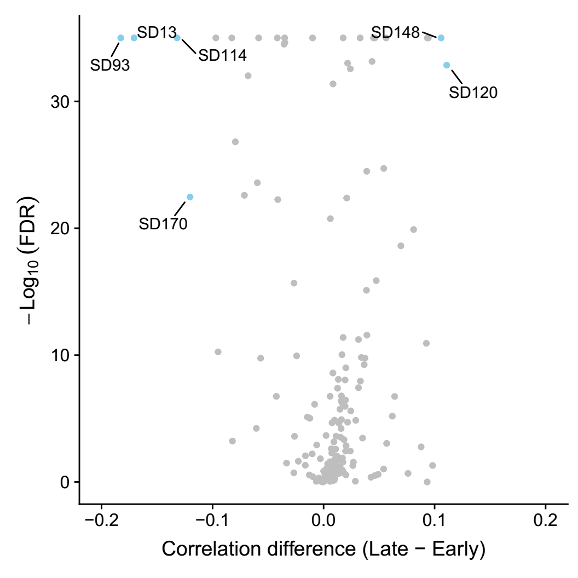
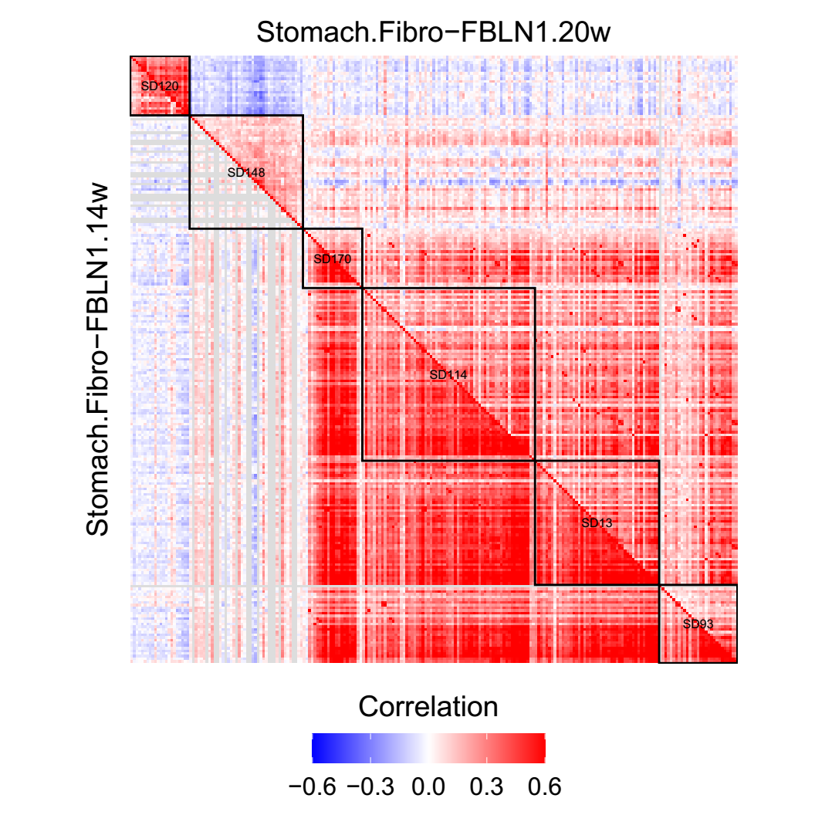
1. Differential modules between different stages
Notes:
77 main cell types
657 cell subtypes

Slide 22
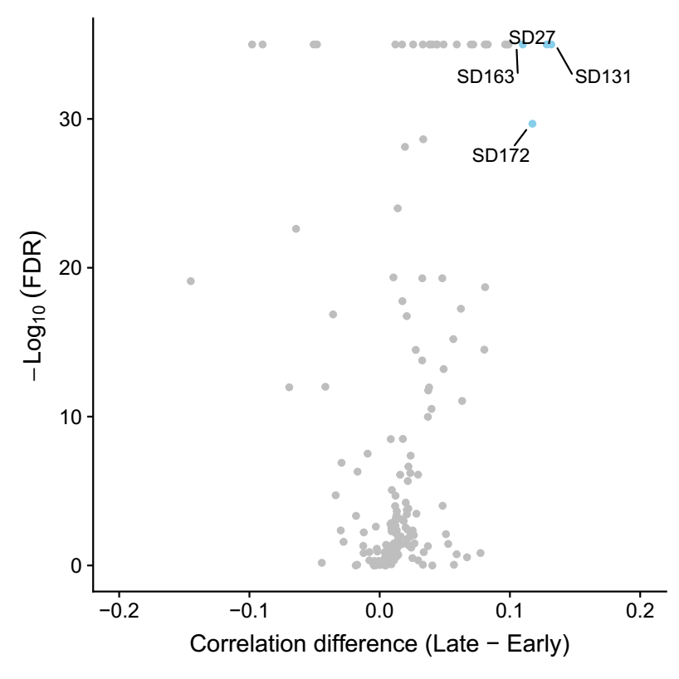
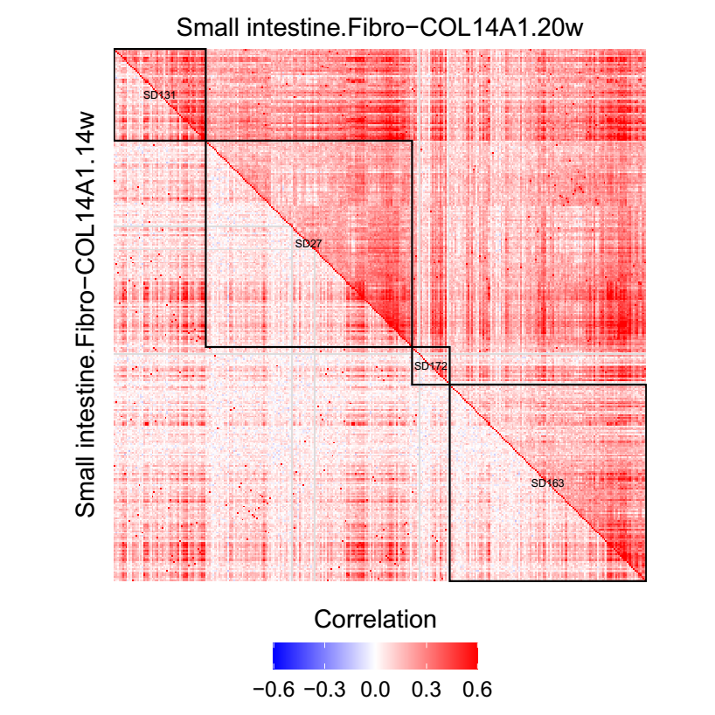
1. Differential modules between different stages
Notes:
77 main cell types
657 cell subtypes

Slide 23
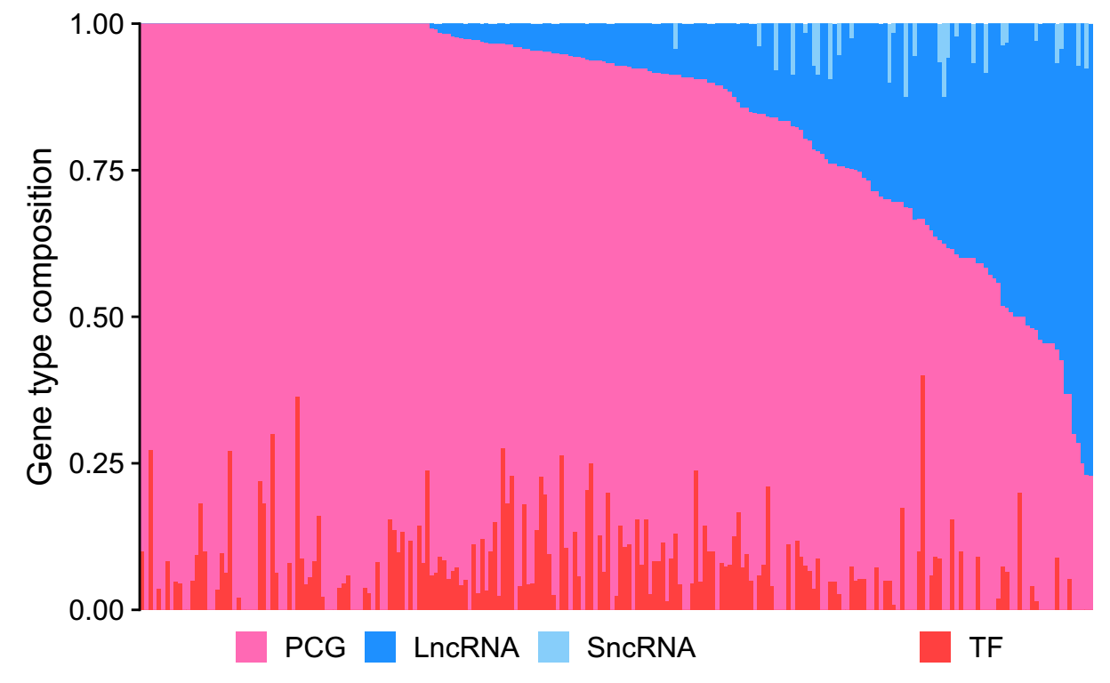
Gene type distribution
Notes:
77 main cell types
657 cell subtypes

Slide 24
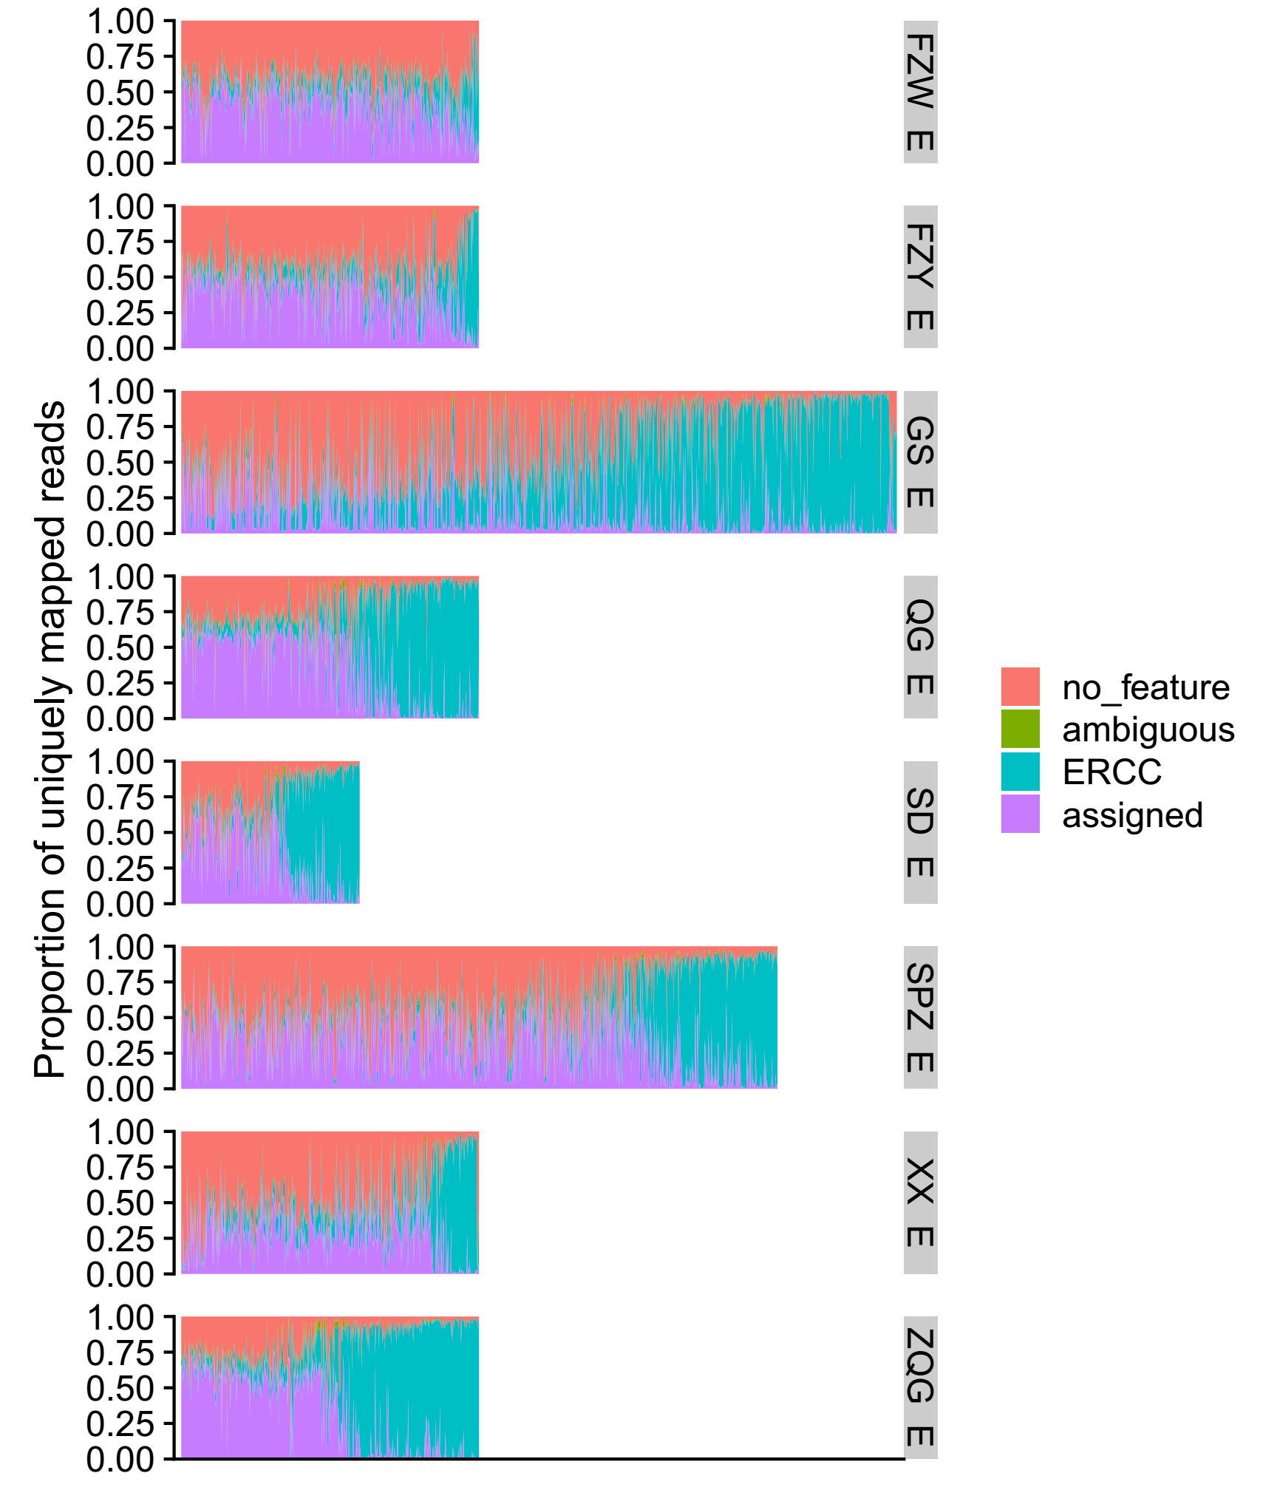
New data
Organ | Total | afterQC | ratio
01_stomach | 4032 | 3146 | 0.780258
02_small_intestine | 4608 | 2915 | 0.632595
03_kidney | 960 | 488 | 0.508333
04_lung | 960 | 638 | 0.664583
09_bone_marrow | 1152 | 106 | 0.092014
10_bronchus | 480 | 145 | 0.302083
12_esophagus | 288 | 112 | 0.388889
17_thymus | 480 | 276 | 0.575
ex_trachea | 480 | 199 | 0.414583
Notes:
77 main cell types
657 cell subtypes

Slide 25
Thanks

